Slide 1
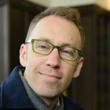
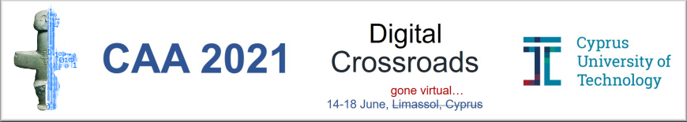
Digital Ecosystems in Archaeological Science: A History and Taxonomy of R packages in Archaeology
Ben Marwick
University of Washington
@benmarwick
June 2021
Notes:
The traditional home of the Coast Salish people, the traditional home of all tribes and bands within the Duwamish, Suquamish, Tulalip and Muckleshoot nations.

Slide 2
What R packages are archaeologists using and how?
How has use of R packages by archaeologists changed over time?
What kinds of R packages are archaeologists making?
Why is this important to know?

Slide 3
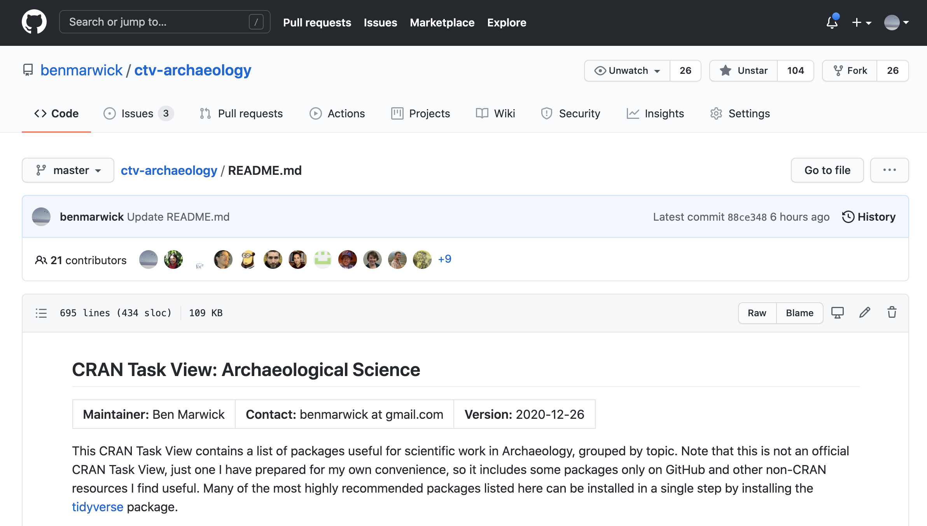
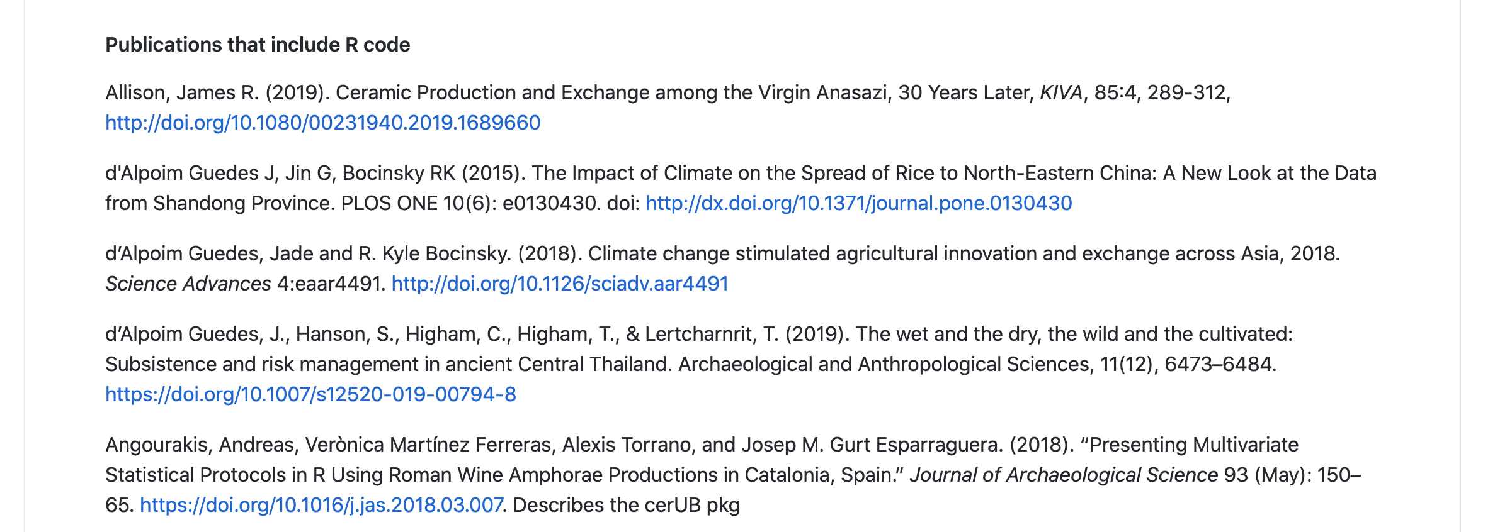
Notes:
This is our data source, a file on a GitHub repo that has a plain text list of papers and chapters. The papers are about archaeology, and have been verified as having openly available R code files.
This is a crowdsourced dataset, thank you to those who have made pull requests or otherwise contributed content to the list. You might be able to recognise yourself among the avatars at the top. Contributions from anyone are warmly welcome.

Slide 4
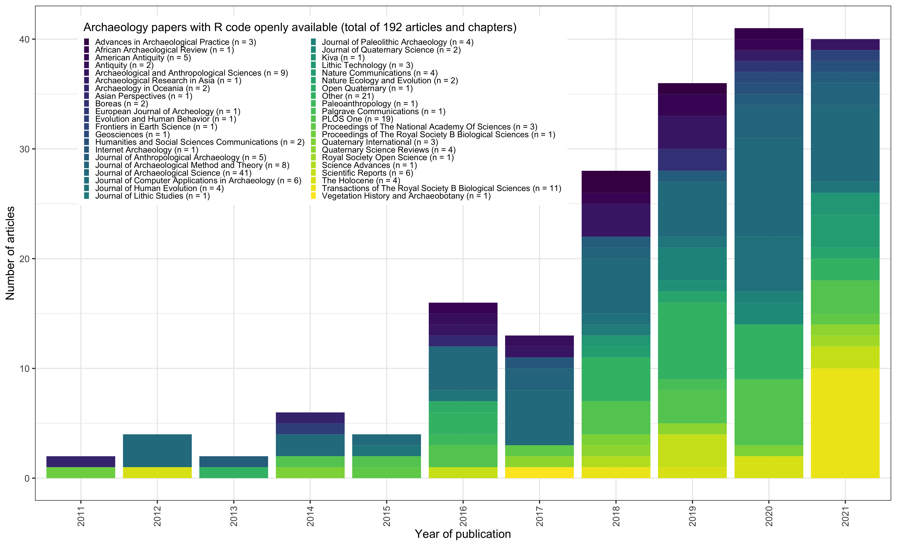
Notes:
Here's a vis showing the number of papers on the list by year, and the major journals represented. Things to note
JAS is the most frequently appearing single journal, probably because it is the highest volume of archaeology papers of any kind
Pretty good geographical coverage, Asia, Europe, Africa, Americas
Tilts towards natural and physical science areas of archaeology
Two specialist stone artefact journals represented here!
Trans Royal Soc B is stand-out with a recent special issue, nearly all papers had R code, thanks to Jennifer C. French, Philip Riris fo their leadership with that.
Huge increase after 2017 when a few important papers on open science and reproducibiltiy were published by archaeologists
We are not even half way through 2021 and nearly at the same number as last year!

Slide 5
Manually downloaded the R code files for all paper on the list
Imported code from plain text, Word, PDF, HTML files (with exclusions)
Used a function originally written by Clemens Schmid for rrtools to extract package names from the code
Notes:
Excluding packrat and renv files, so we only get pkgs intentionally cited by archaeologists, and not all their dependencies also
By far the majority of files were R/Rmd, with a smaller number in PDF and Word doc, which are high friction formats for working with code, don't use those. One paper had an image of code.

Slide 6
What R packages are archaeologists using?

Slide 7
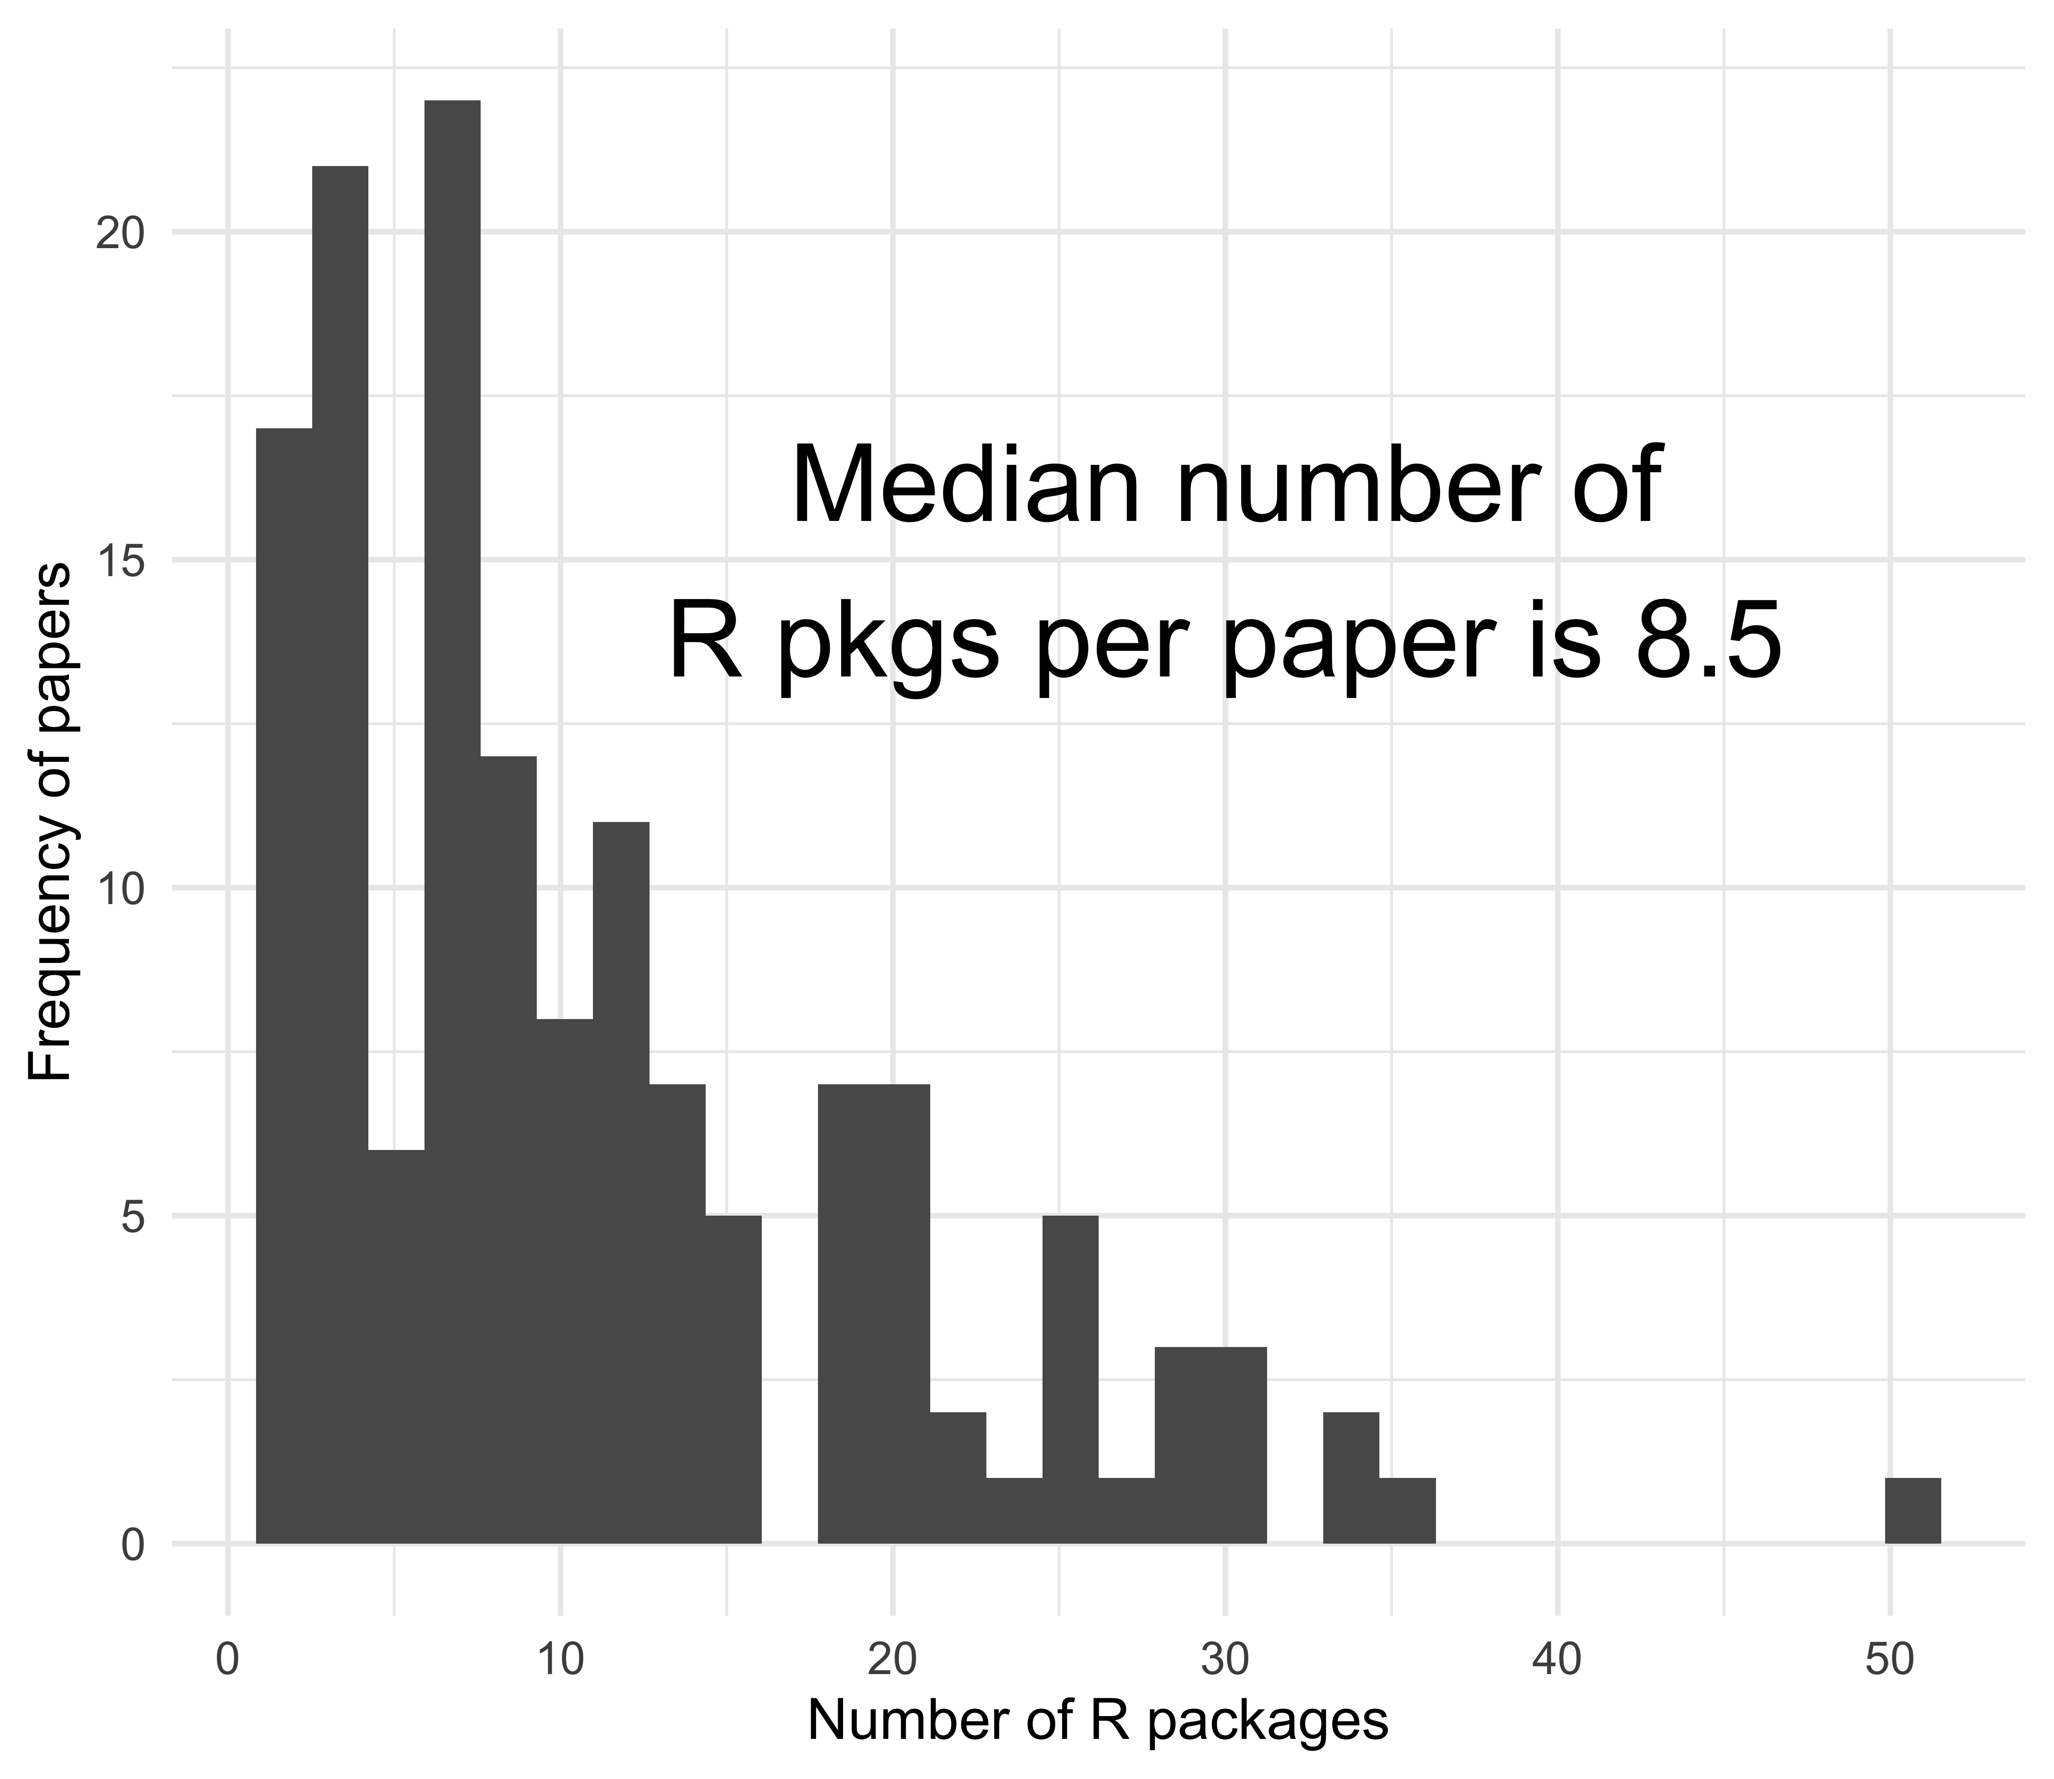
Notes:
Packages per paper… not very many!

Slide 8
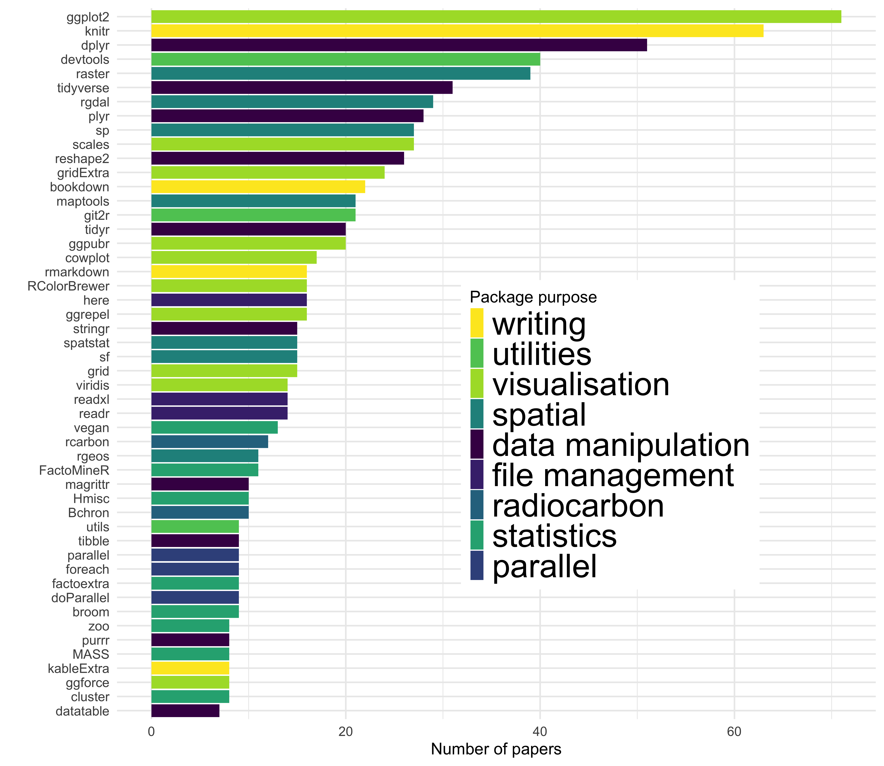
Notes:
Here are the 50 most frequently used R packages in the 192 papers on our list. Interesting things here are:
ggplot2 for plotting as #1, confirming R as a language with excellent data viz capabilities
Knitr for writing R Markdown documents that weave code and text in the same file, indicating that reproducibility is a priority for the authors of these papers
The category of packages for writing is the largest category of all (these are labelled by hand by me)
Pkgs for working with radiocarbon data, as a specialist archaeological data type that has excellent tooling in R
For R users, the tidyverse vs datatable rivalry has a clear winner here, the tidyverse

Slide 9
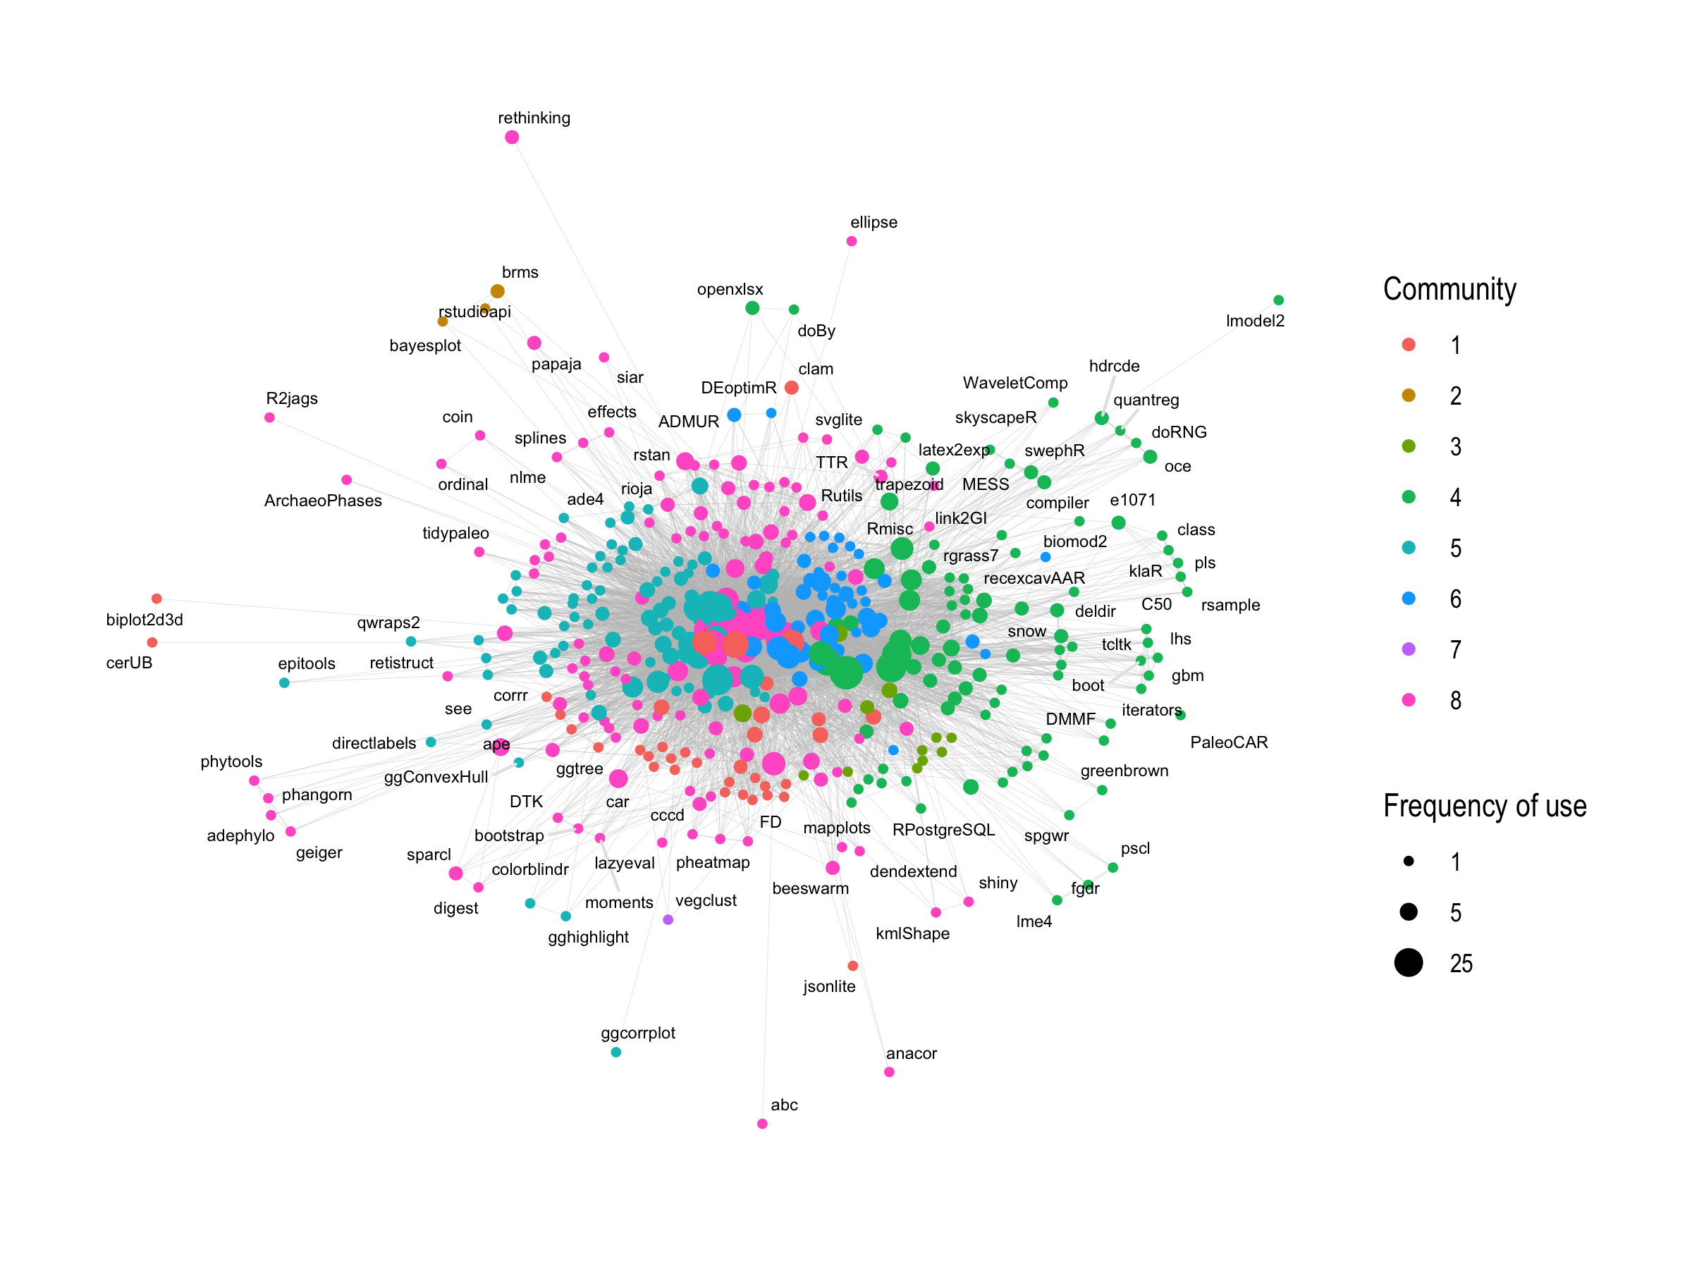
Notes:
Network of co-citation of packages, showing communities of highly co-cited packages, most of the labels are not shown
But we can see:
One giant hairball - most people are using a very similar set of core packages
Machine learning
phylogenetics
Bayesian

Slide 10
Bayesian
Dating
Machine learning
Spatial
HPC
Visualization
Modelling
Phylogenetics
Notes:
Network of co-citation of packages, showing communities of highly co-cited packages, most of the labels are not shown
But we can see:
One giant hairball - most people are using a very similar set of core packages
Machine learning
phylogenetics
Bayesian

Slide 11
How has use of R packages by archaeologists changed over time?

Slide 12
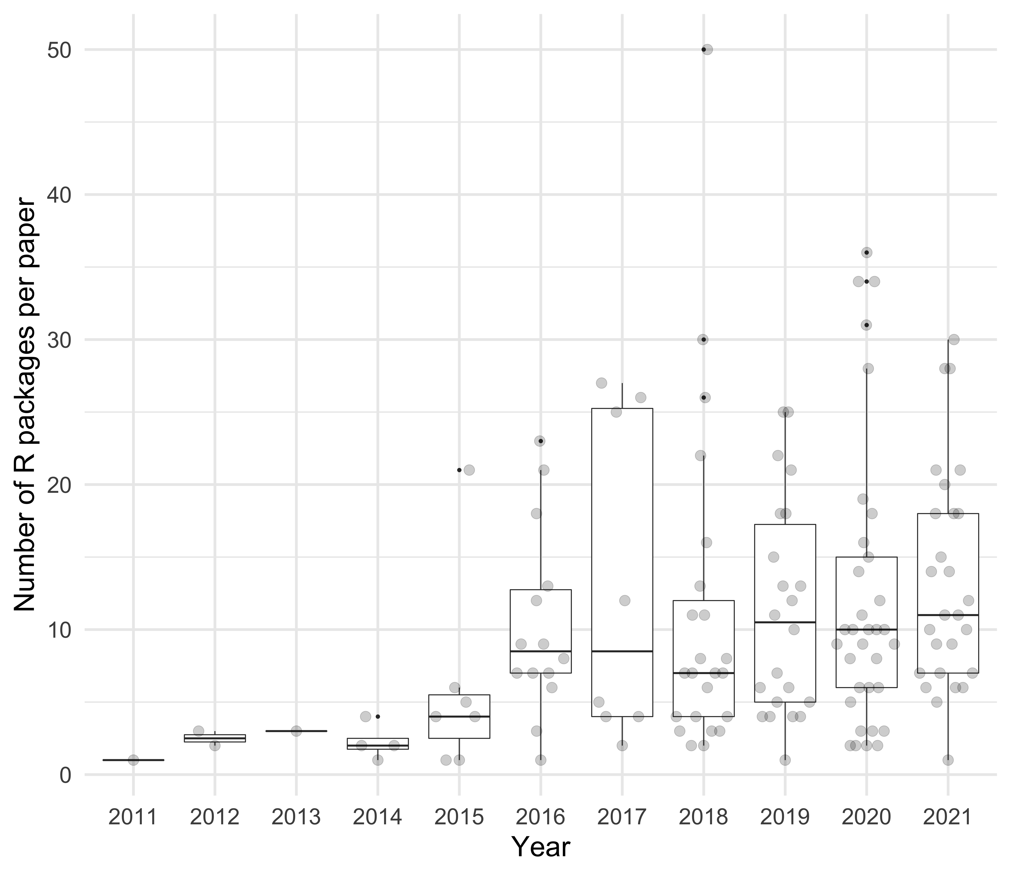
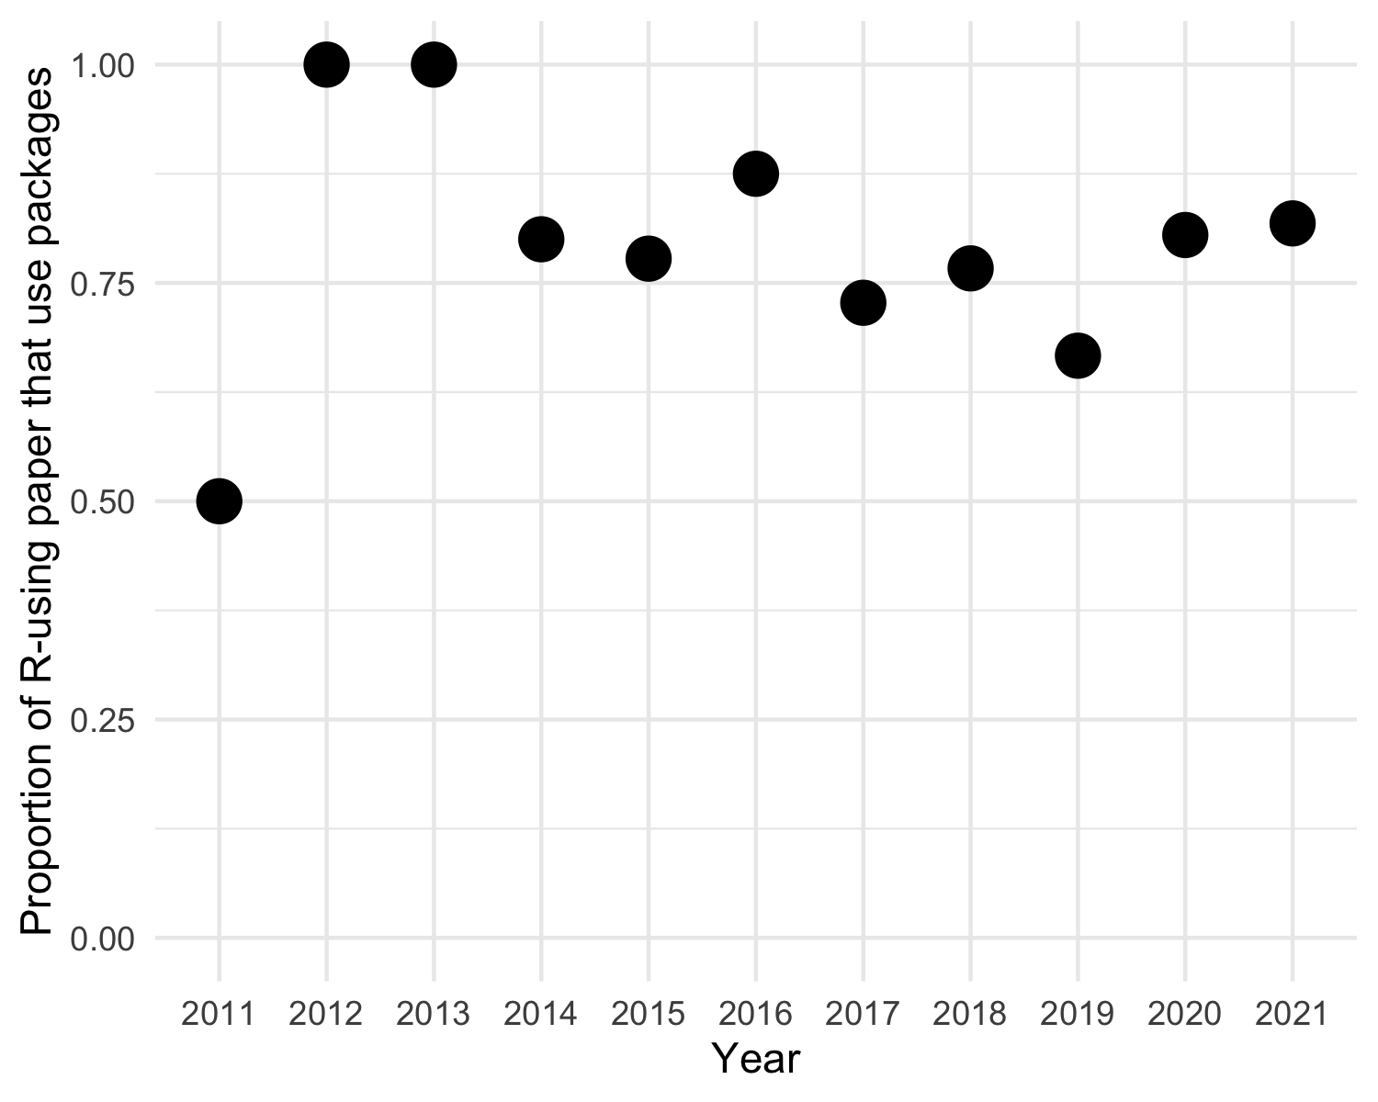
Notes:
Turning now to packages per paper, over time

Slide 13
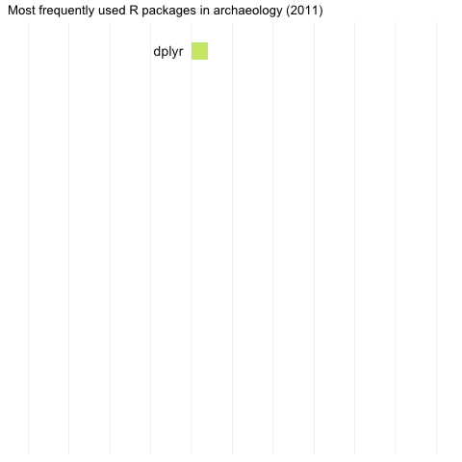
Notes:
Turning now to packages per year…

Slide 14
What kinds of R packages are archaeologists making?

Slide 15
Scraped GitHub search results*
Scraped GitHub repository file listings
Used GitHub search API to get details*
Notes:
To find out the packages that archaeologists are making, I searched GitHub for the keyword 'archaeology' and repositories containing R code. GitHub search API is not very good, and it missed results that I knew were there. So this is not a highly accurate result, but it is reproducible. The result include CRAN packages, because there is an un-official CRAN mirror on GitHub. But they do not include pkgs not on CRAN that are on other repos, such as GitLab, BitBucket, etc.

Slide 16
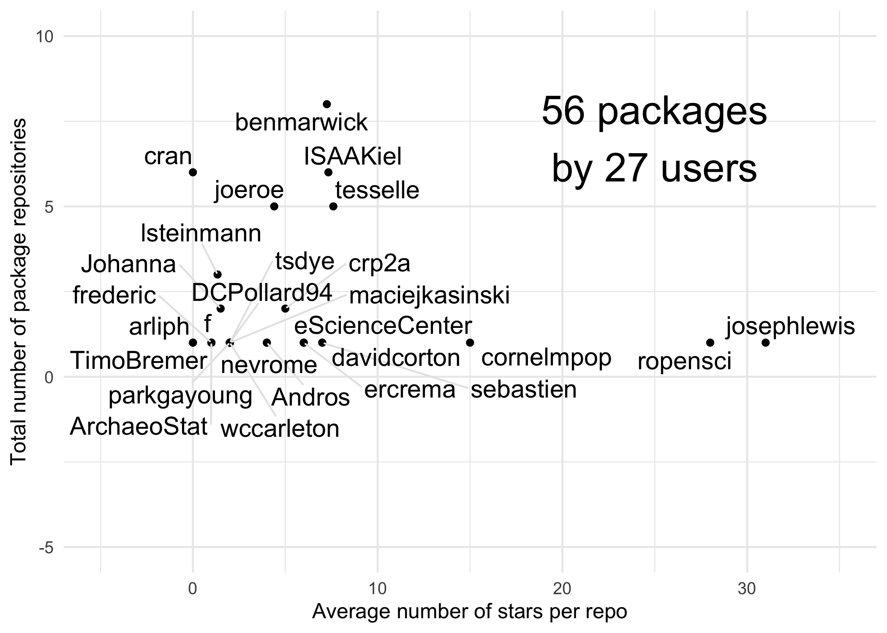

Slide 17
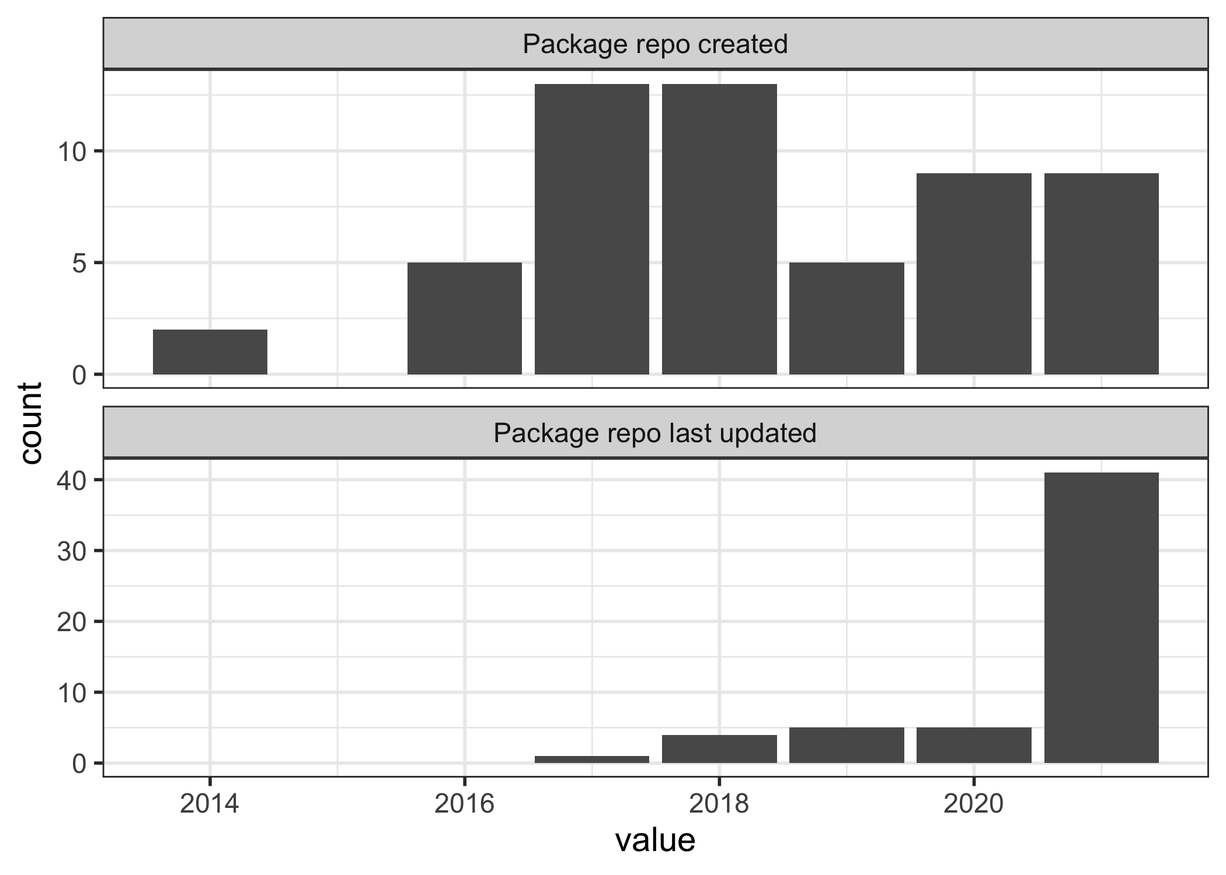
Notes:
The earliest pkg in our data comes from 2014, with an uptick in 2017 that has continued
Pkgs seem to be maintained regularly, with most pkgs last updated in the last year

Slide 18
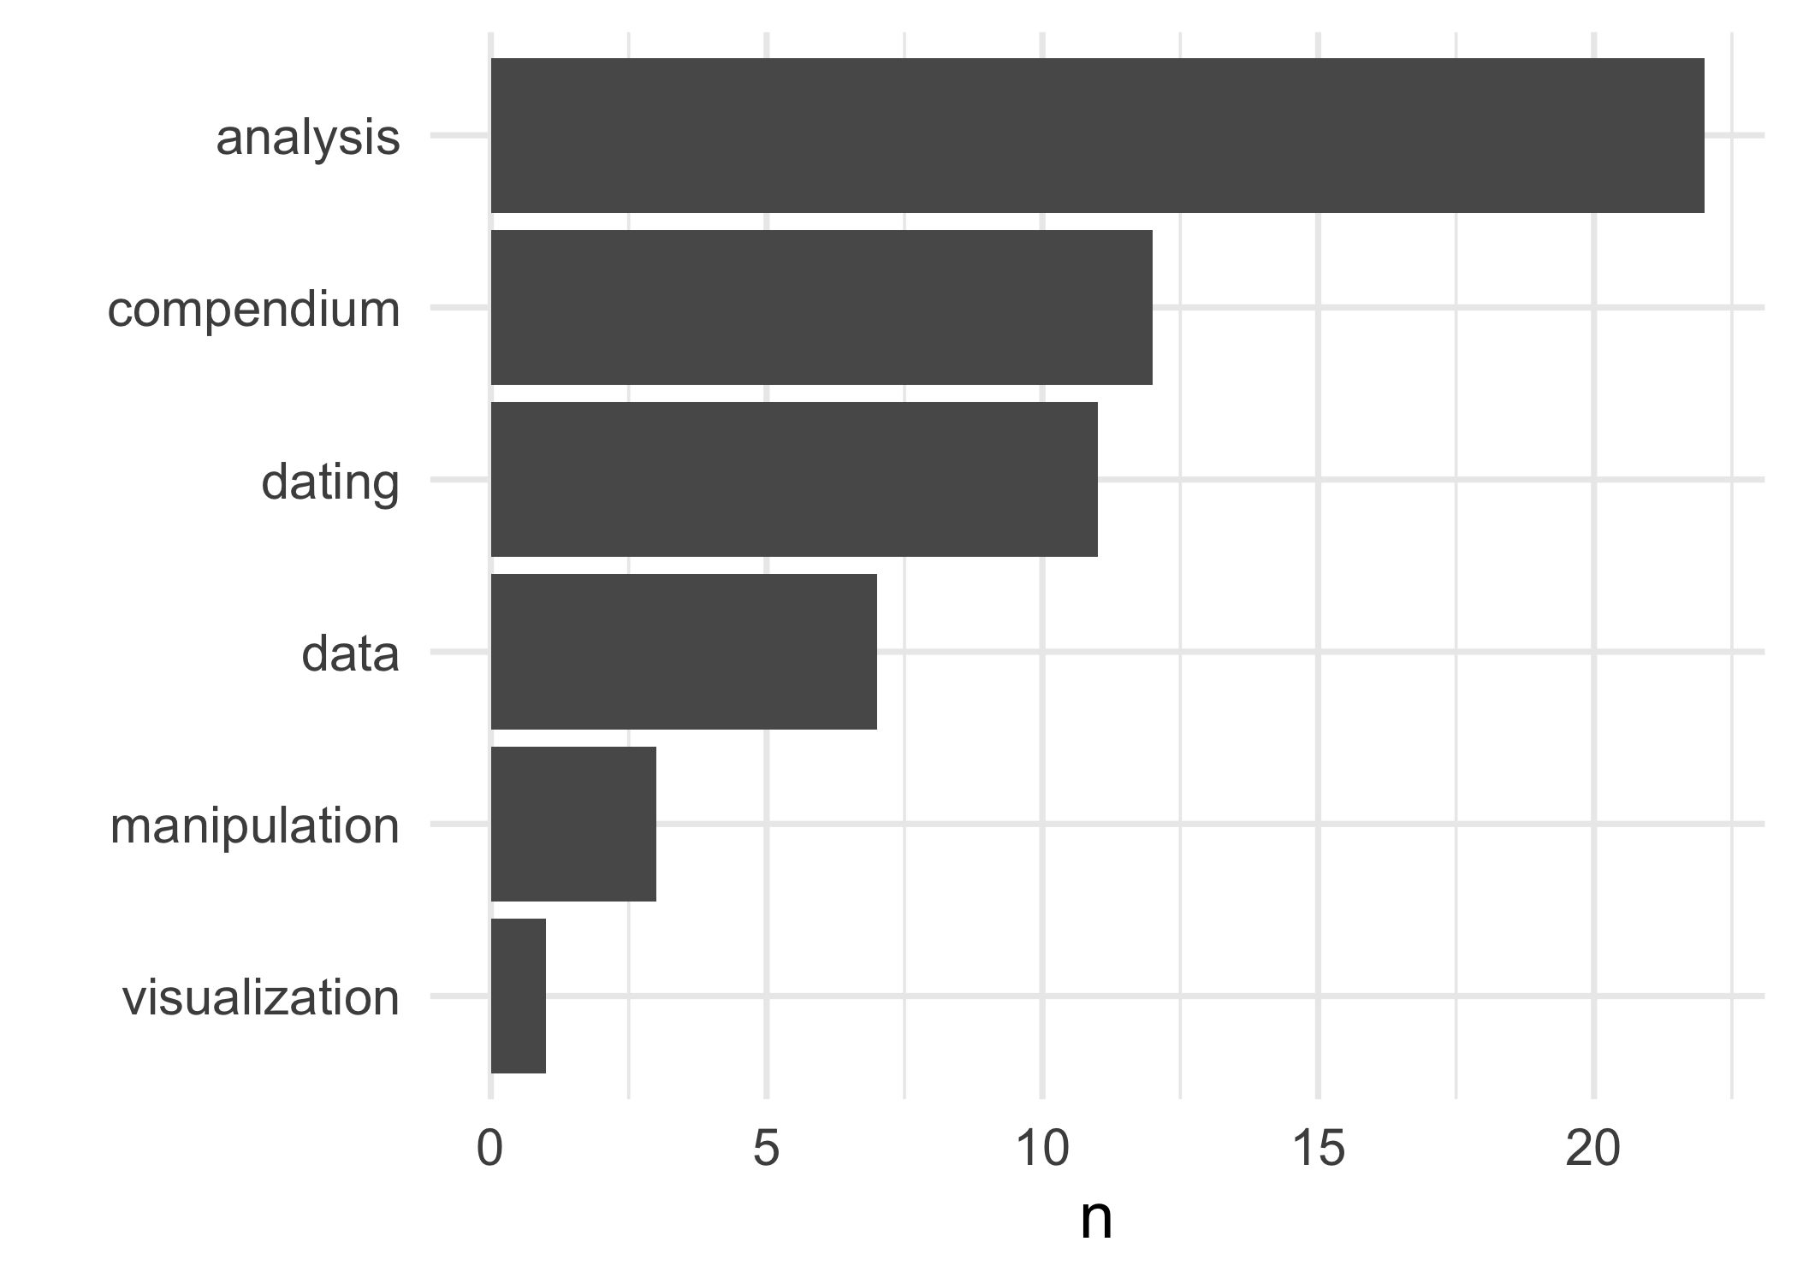
Notes:
Most pkgs are for data analysis of some kind, especially ceramics and lithics, also stratigraphy
A compendium is a pkg to accompany a publication, to take advantage of the familiar pkg structure to enable others to easily reproduce the published results
A data package is a package that has several data sets from previously published work, usually intended for teaching purposes

Slide 19
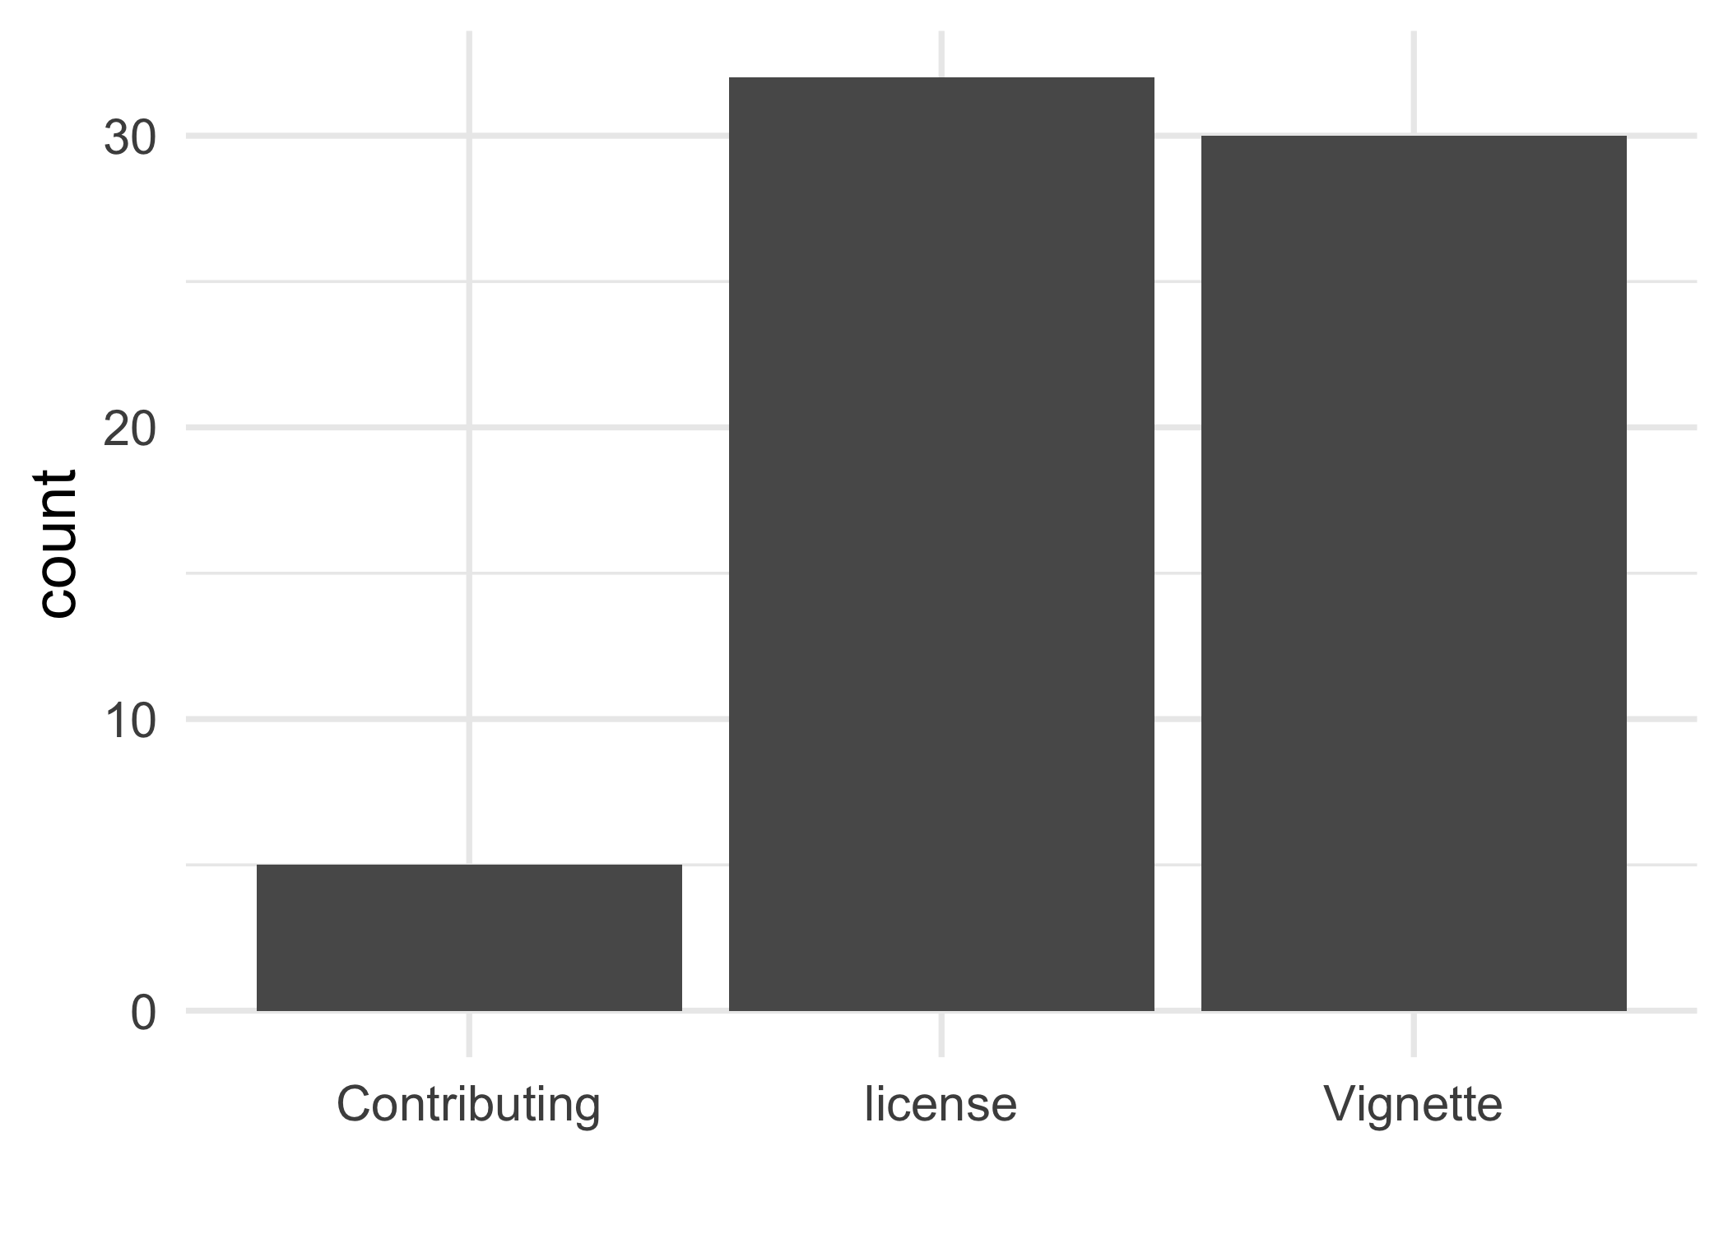
rOpenSci package development handbook and the usethis pkg make it very easy to make your package user-friendly and accessible to novices

Slide 20
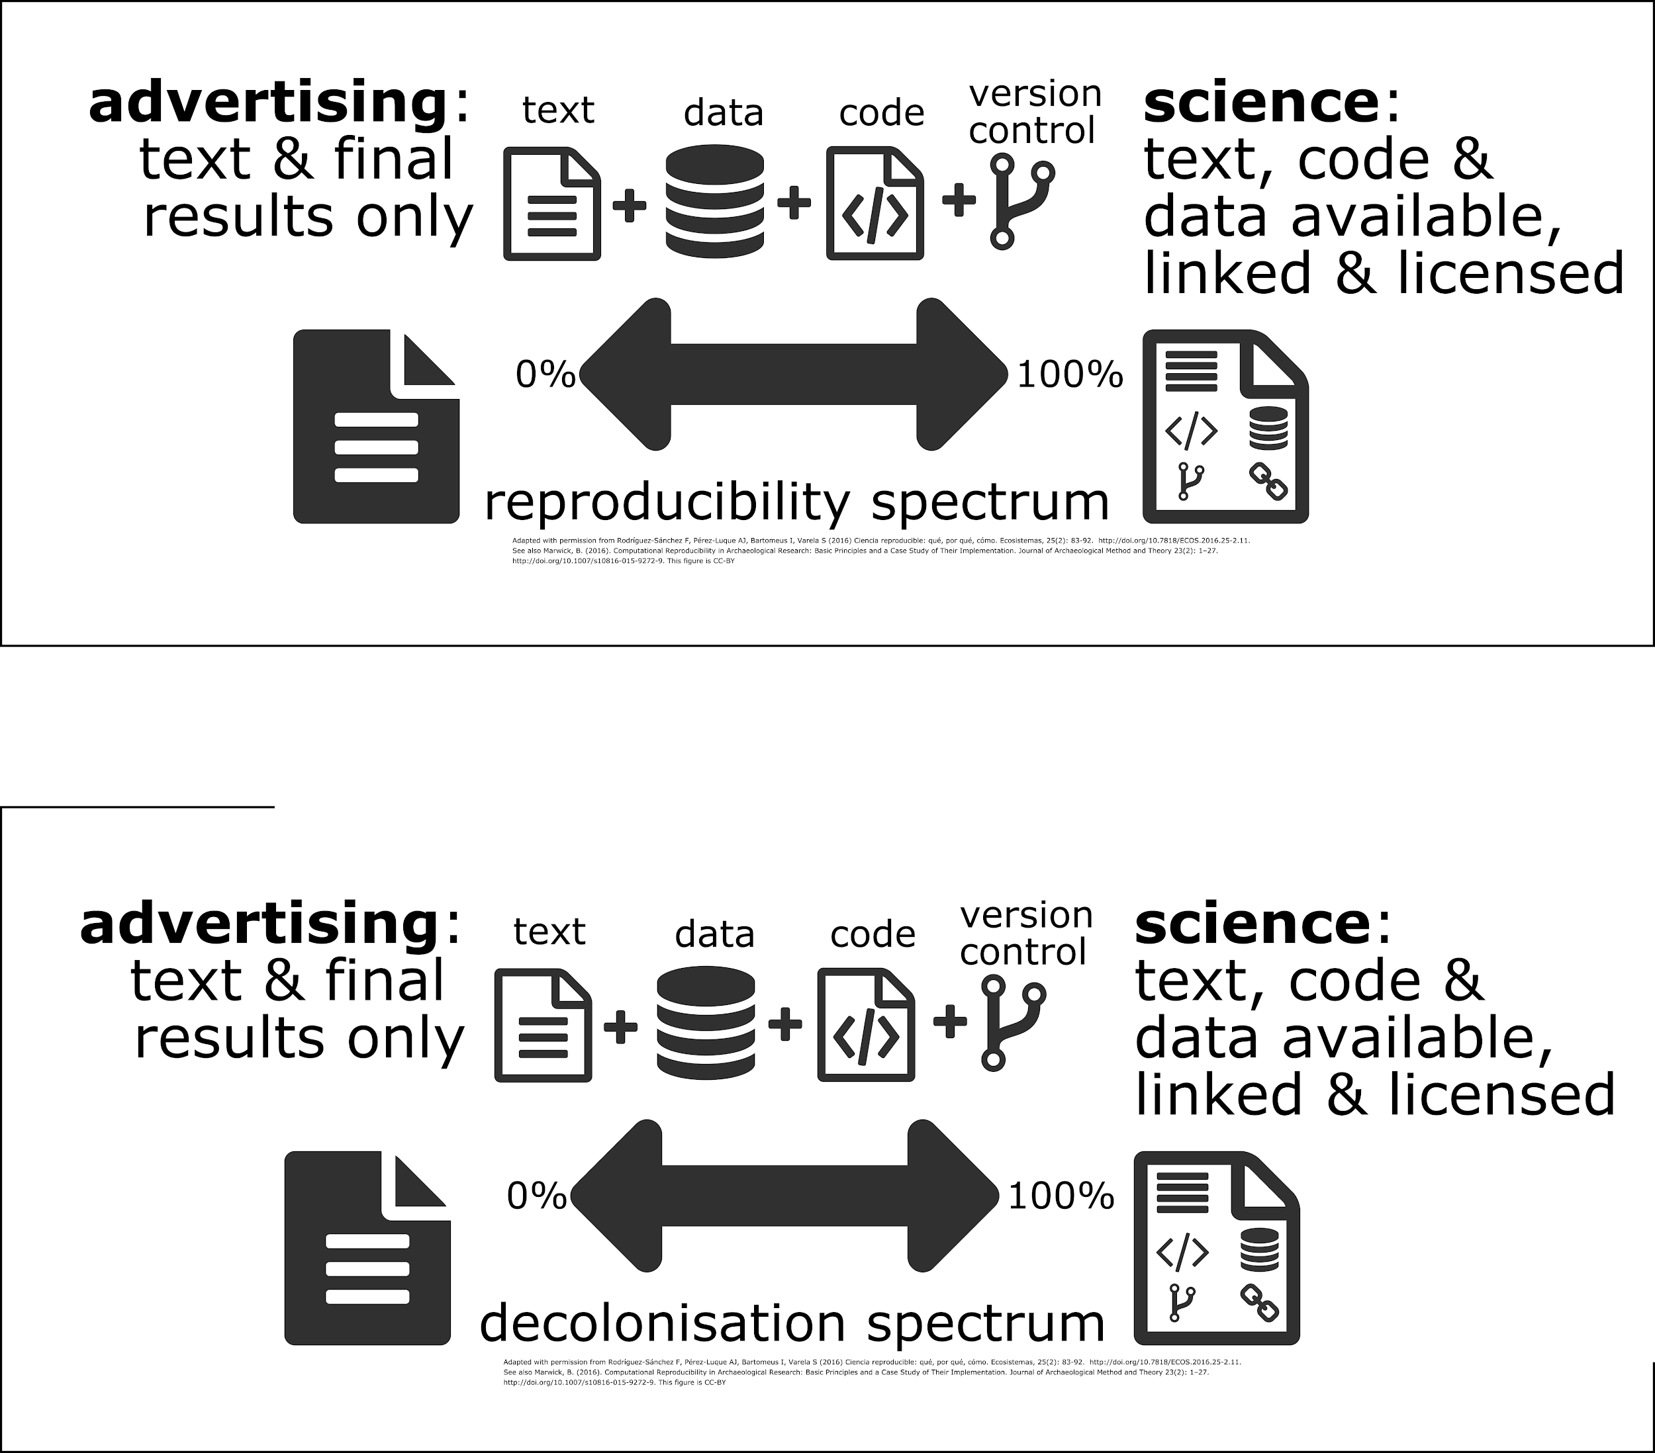

Slide 21
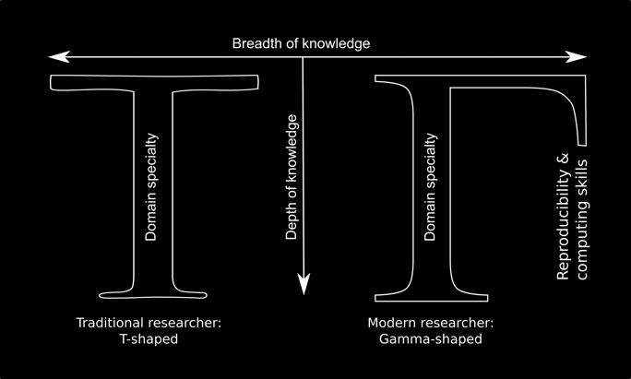
Implications for preparing researchers to do decolonizing archaeology
Fiore-Gartland, B. & Tanweer, A. Community-level data science and its spheres of influence: beyond novelty. eScience Institute (2015). http://escience.washington.edu/community-level-data-science-and-its-spheres-of-influence-beyond-novelty-squared/

Slide 22
Conclusions
The logics of colonial systems point to unrealised opportunities for decolonising archaeological science
Behaviours around data indicate colonial logics of elimination, commodification, and accumulation
Galisonian logic devices provide affordances to undoing these colonial logics
Evidence of these affordances is uneven in archaeological science, but increasing
Normal research activities offer many opportunities for decolonising actions

